Slide 1
TASK-1
Web Scraping to gain Company Insights

Slide 2
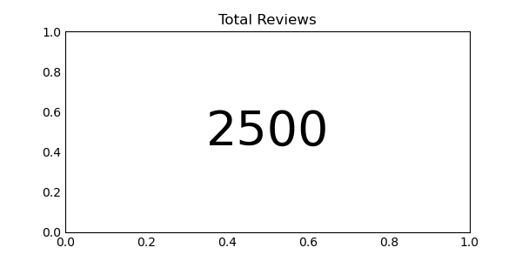
Total Reviews
For this Analysis, I extracted and used 2500 reviews.

Slide 3
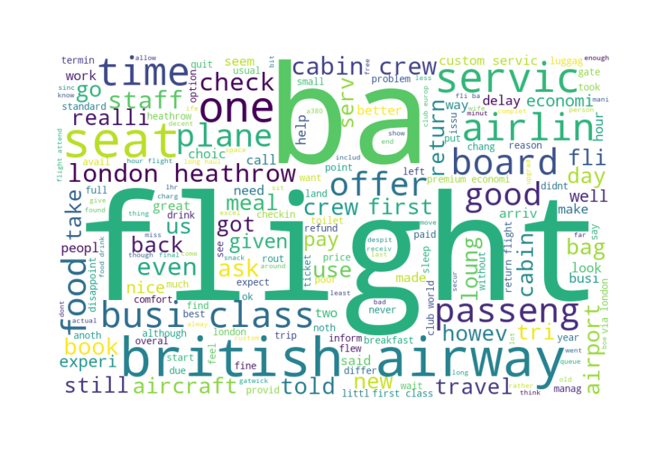
Word Cloud

Slide 4
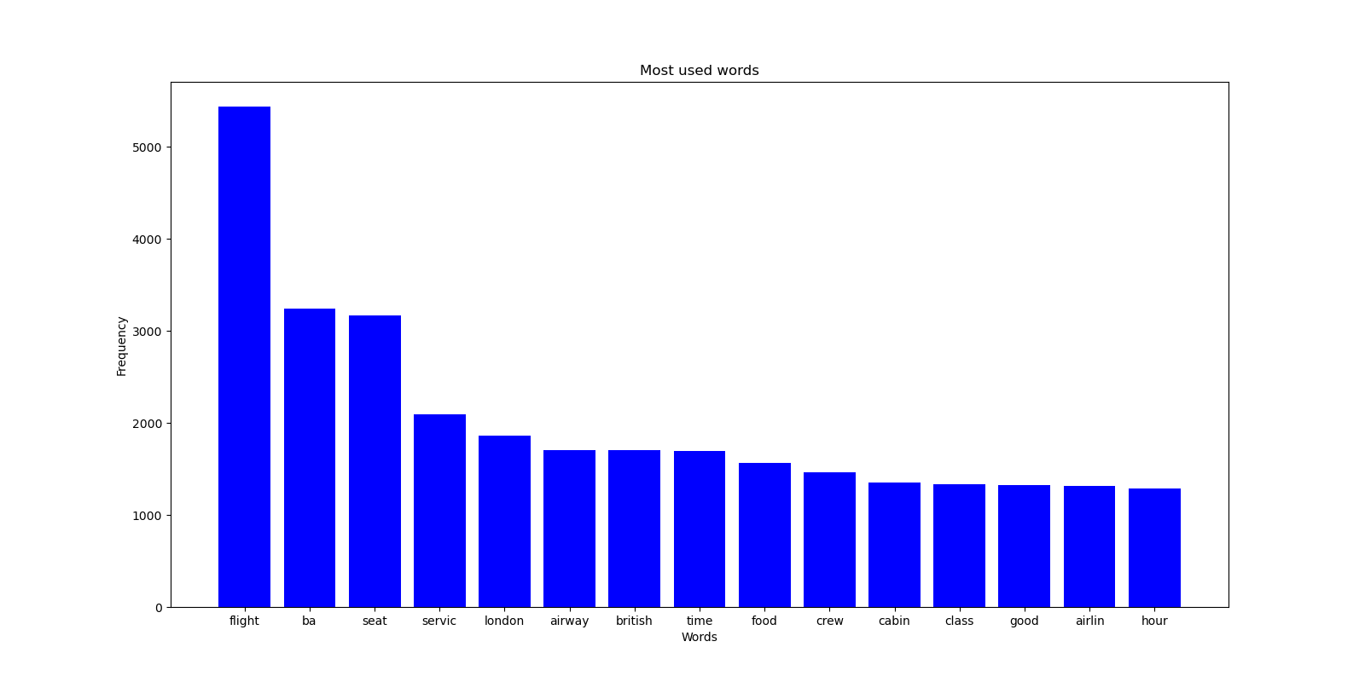
Frequency of Words
Here we can see the most used words by reviewers in their reviews
This words include for both positive and negative reviews

Slide 5
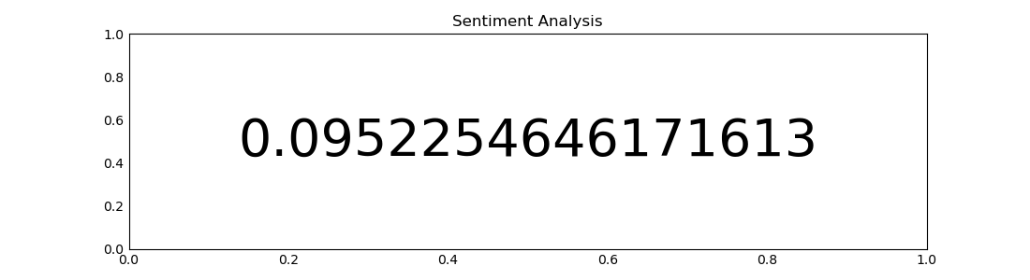
Sentiment Analysis
This is the Mean Sentiment Analysis of all the reviews.
It is Slightly positive.
From this we can say that the reviews from users/reviewers is neutral

Slide 6
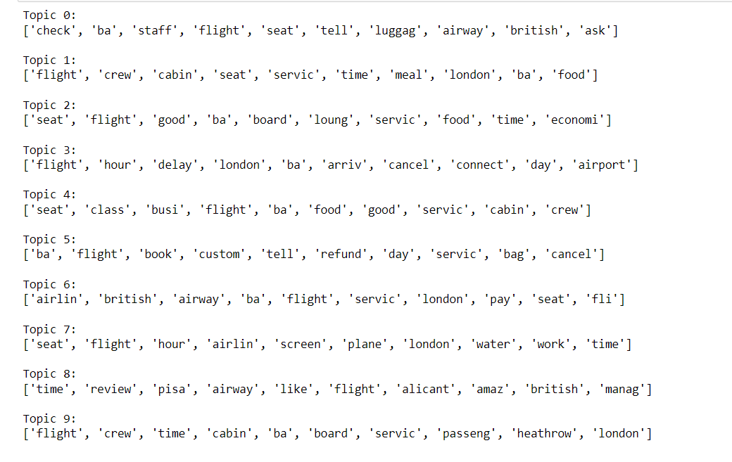
Topic Modeling

